Slide 1
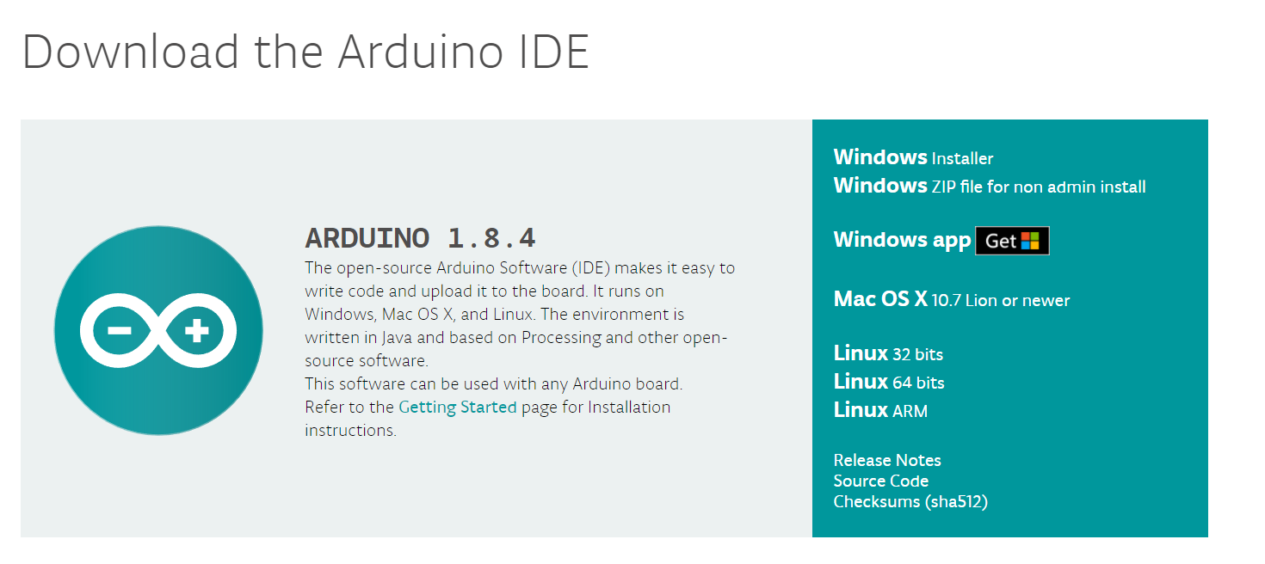
Sensors!!
https://www.arduino.cc/en/Main/Software

Slide 2
Sensors: What do they do?
Take real world information and translate it to a way the Arduino / microcontrollers can understand
Many types of sensors for various applications (sounds, lights, etc..)
You can make your program do special things based on sensory input: when it’s too loud, when the ambient light is really low, and many more

Slide 3
How do they work?
Different sensors have different implementations
All basic sensors convey information to the Arduino over a single Analog input (more advanced sensors can use more)
The rest is up to you! You decide when you want to read the information, and what to do with it

Slide 4
Some points before we get started…
The Arduinos we usually use are 5V. The other most common is 3.3V, which some sensors may require (we will see this later)
For all basic sensors, we can assume they will use 5V

Slide 5
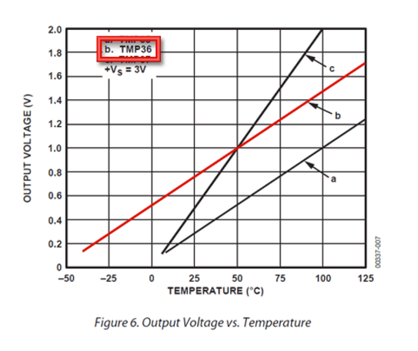
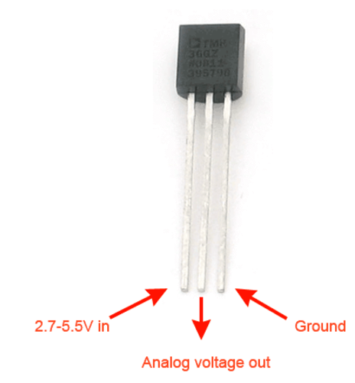
Thermal
The output voltage changes based on the temperature (sent to and read by the Arduino)
See Graph: Amount of volts changes with temperature

Slide 6
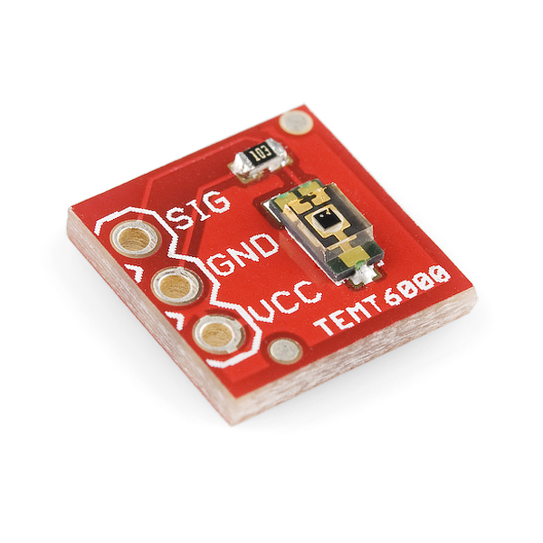
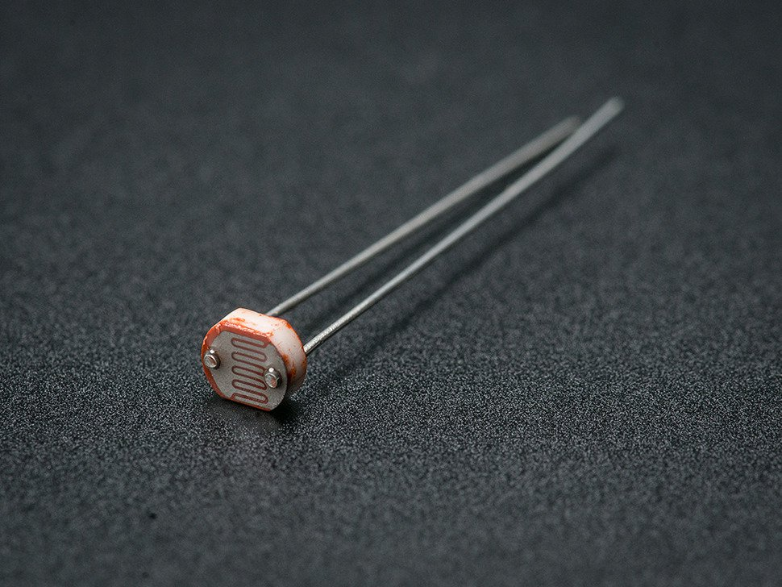
Photoresistor and Light Sensor

Slide 7
Photoresistor and Light Sensor
Both serve the same purpose: determine surrounding light levels
Different implementations! But in both cases the voltage on the analog pin is higher the more light there is

Slide 8
Photoresistor
Acts as a variable resistor
5-10KΩ in light, 200KΩ in the dark
The amount of voltage dropped
across this resistor (which you can
read on an Arduino) indicates how big the resistance is.
The darker it is, more voltage is lost across this sensor

Slide 9
Light Sensor
More light = sends more voltage to the
analog pin
Note there are 3 contact points here, so the wiring will be a little different
The SIG point will output some voltage depending on how bright it is, which we can use to determine brightness

Slide 10
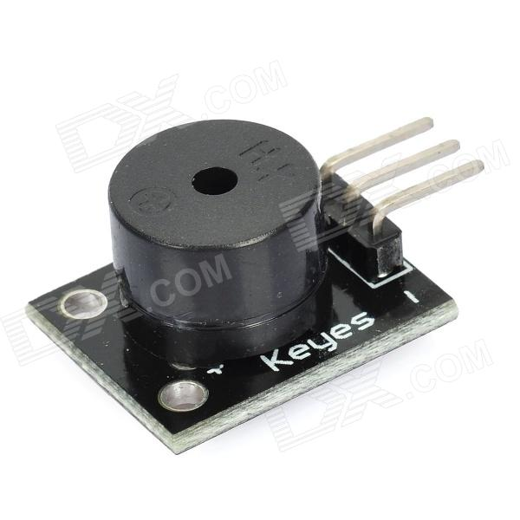
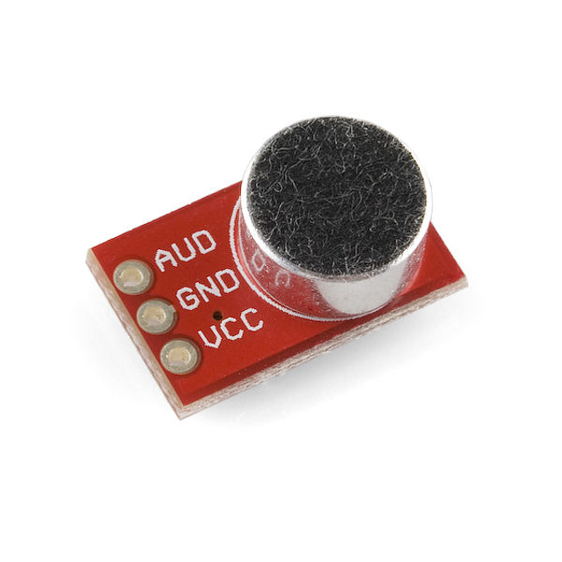
Mic and Speaker
Technically a speaker/buzzer module

Slide 11
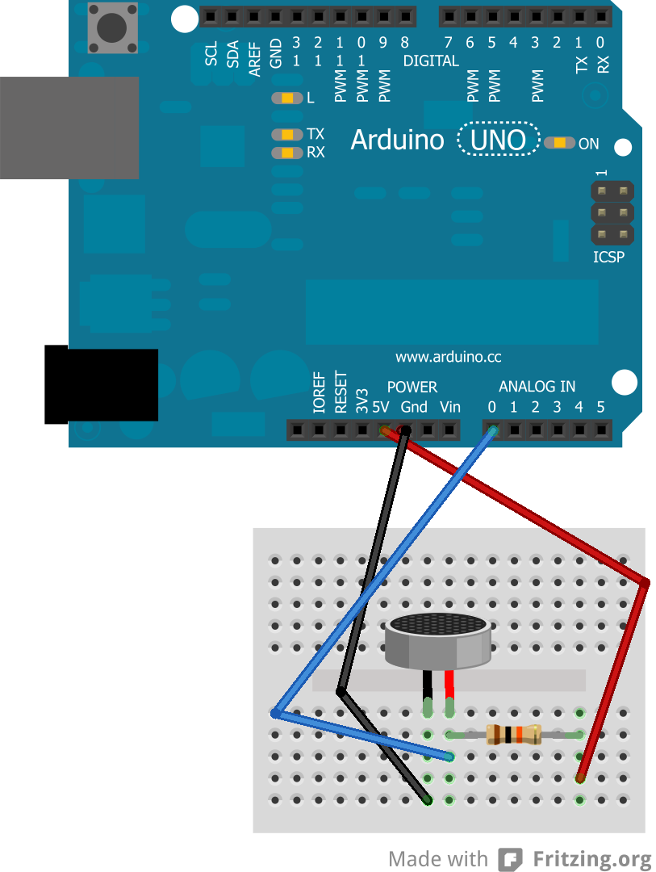
Mic
When sound waves hit the mic, it is
converted into an electrical signal
Read here by the analog input A0.
The Arduino can then interpret this
Information and act on it
For example….

Slide 12
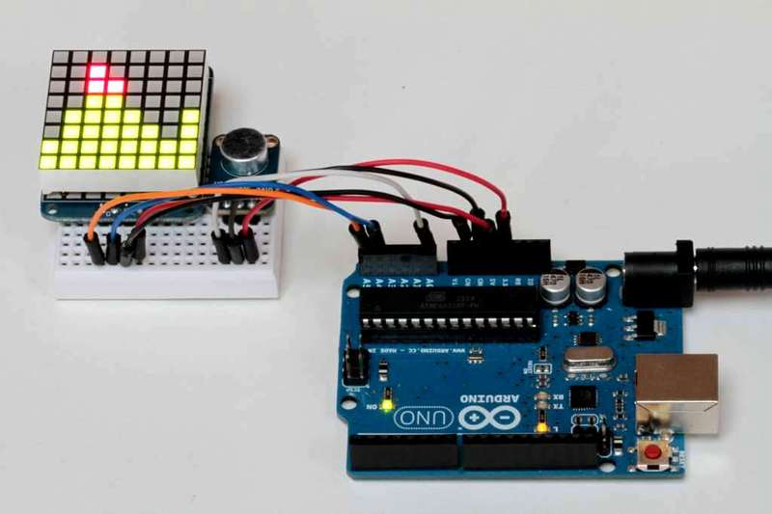
Cool Visualizer effects

Slide 13
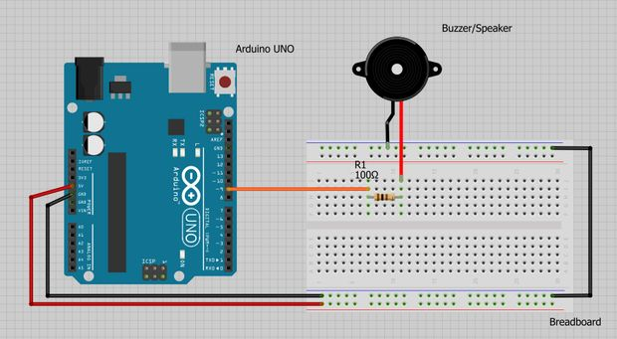
Speaker
The reverse of a mic, this
Device converts the electrical
Signals into sound waves.
To use this, the output wire to the speaker must support Pulse Width Modulation (PWM, denoted by ~ on an Arduino), meaning that you can specify a voltage value from 0 – 5V
You can pick how much power you want to send and thus the loudness of the speaker

Slide 14
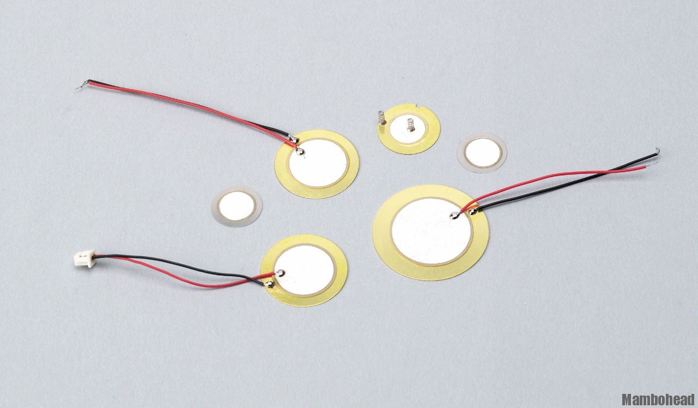
Piezoelectric Sensors
Are sensitive to pressure or touch
Converts the intensity of the touch into a voltage output to the Arduino
Very good for experimenting with different thresholds as the ones we have are fairly sensitive

Slide 15
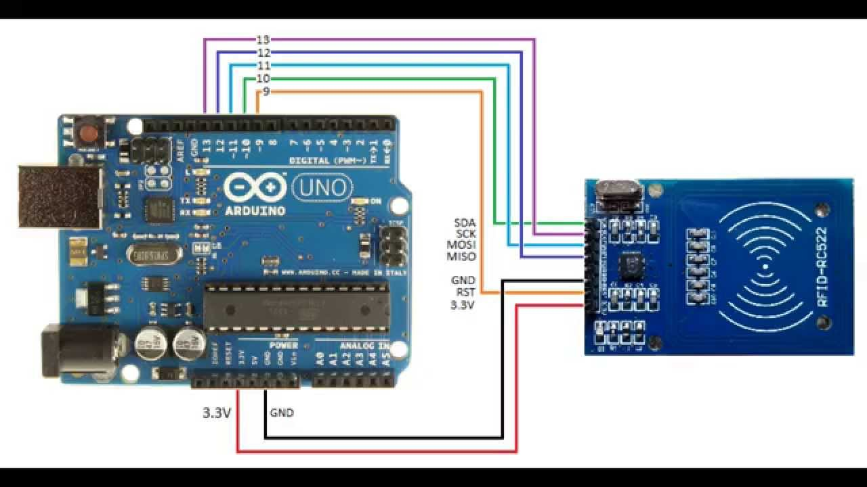
RFID (Advanced)

Slide 16
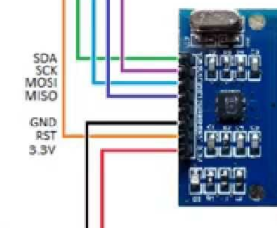
Closer Look
Data
Power
This is used to sign-in here!
Note that this input is 3.3V
Simply put, data is sent over SDA, SCK, MOSI, MISO when an RFID tag is tapped to the sensing area of the board
This specific chip can also write data to RFID chips
This is much more advanced than the other types of sensors previously discussed

Slide 17
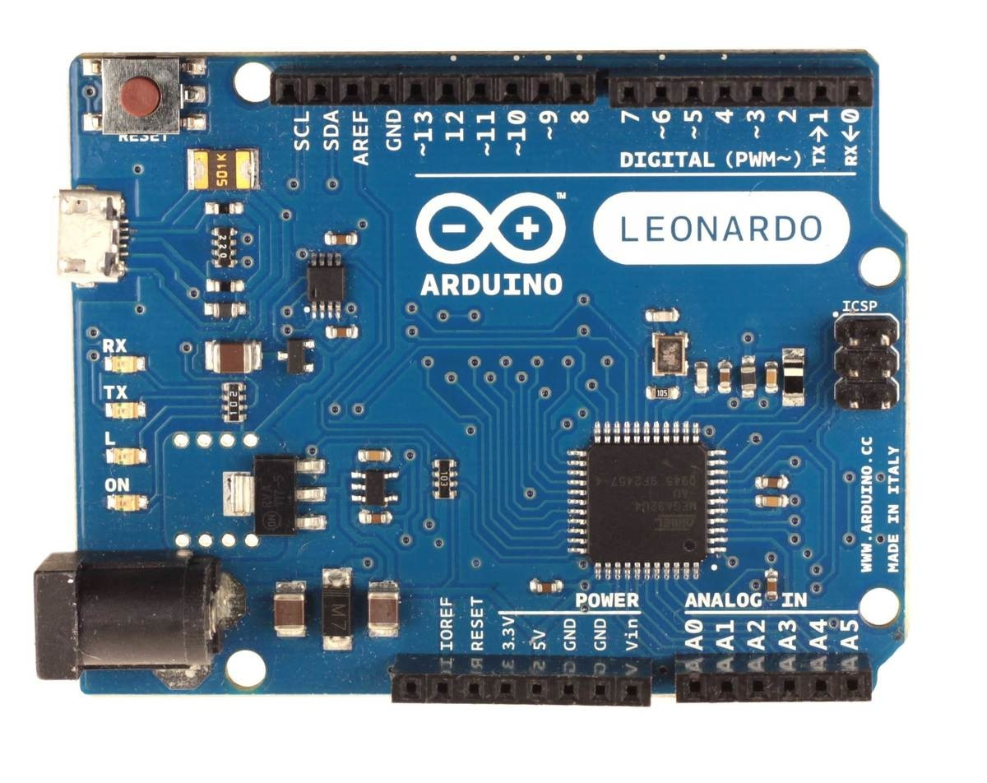
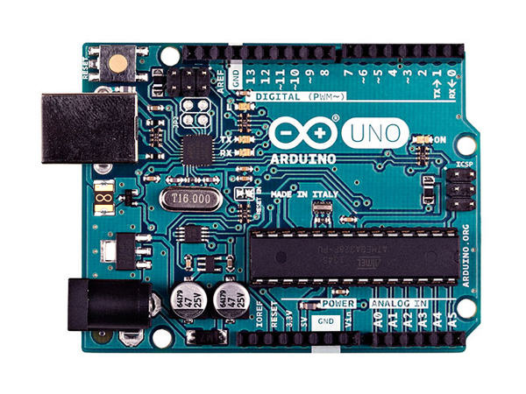
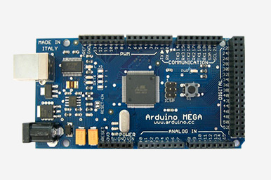
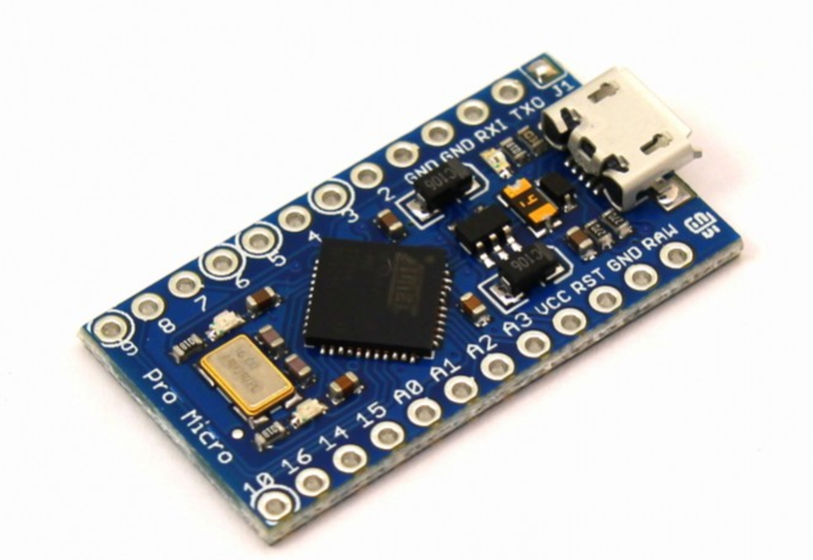
Arduino

Slide 18
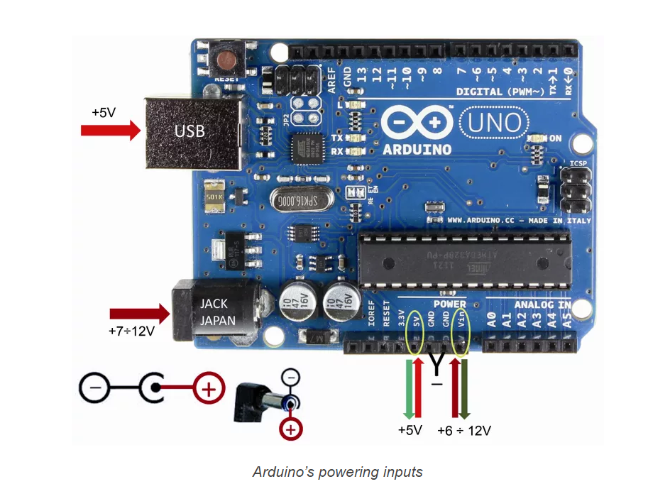
Arduino Power
Notes:
https://www.open-electronics.org/the-power-of-arduino-this-unknown/

Slide 19
Arduino Communication
Arduinos have analog and digital pins
Digital:
Can send power 0 – 5V (or 3.3V on some other Arudino models)
Special PWM pins (denoted by ~) can send between 0 and 5V
Can read inputs, but not the intensity of it (just on or off)
Analog
Can only read, but can read the intensity of an input
Reported as a number between 0 – 1023 (scaled 0 – 5V)

Slide 20
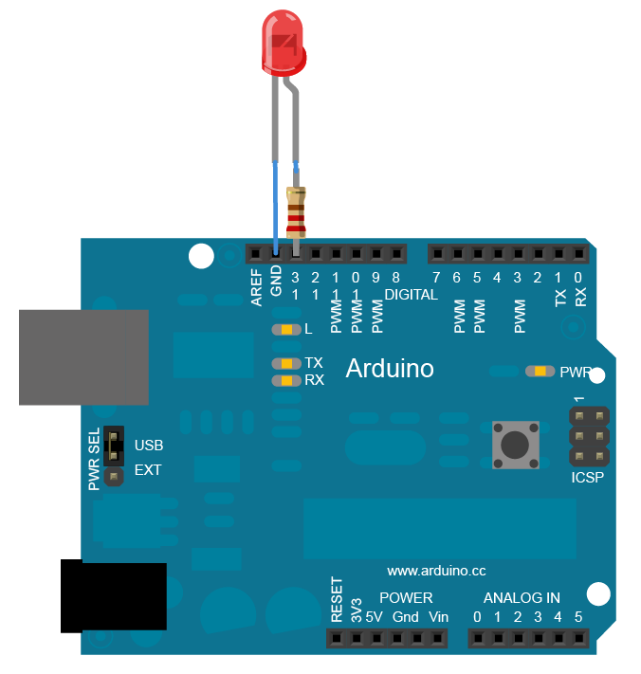
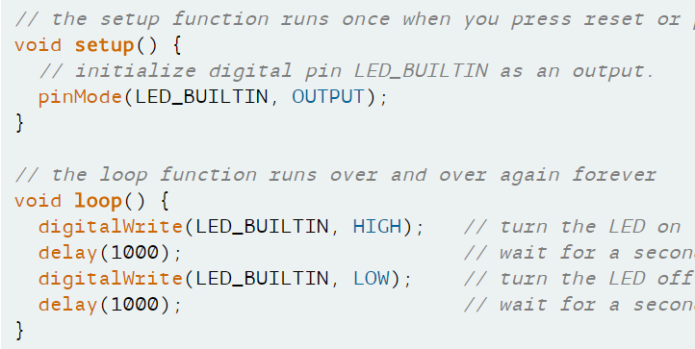
Power output
Ground
(LED_BUILTIN = 13)
Note: Times are always given in Milliseconds
Notes:
https://www.arduino.cc/en/Tutorial/Blink

Slide 21
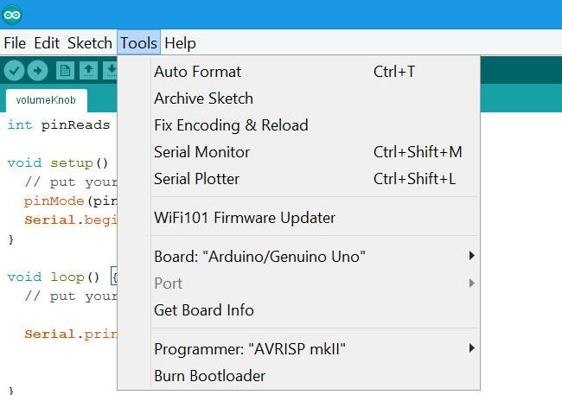
Serial Monitor
The premade sketches will write information here for you to see!

Slide 22
Downloadable Sketches
Potentiometers control LEDs
Thermal sensors control LEDs
Photoresistor control LEDs
Piezo and Speakers
https://goo.gl/dpqBQH

Slide 23
Final Points before starting
Be sure to place a 330 Ohm resistor in between your sensor and GND to protect the component
Ensure that the Thermal sensor, is inserted in the proper orientation
Change the board type from default (Arduino Uno) to Mega

Slide 24
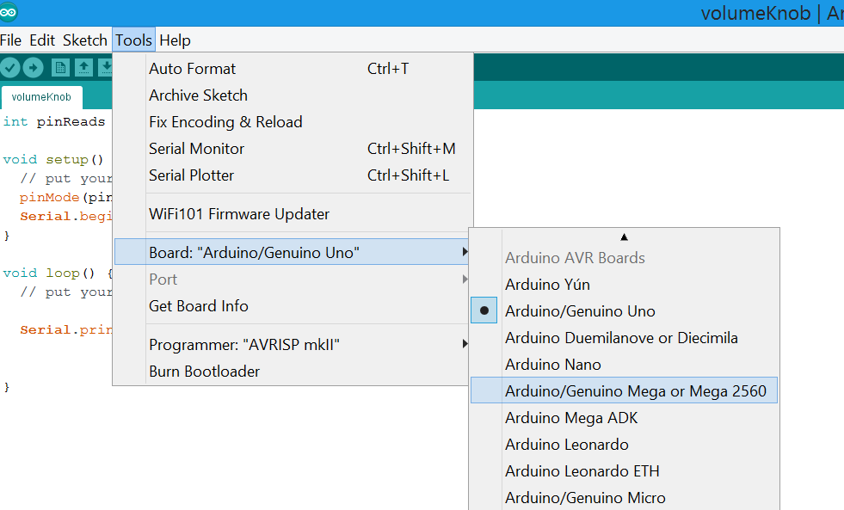

Slide 25
Download Sketches at:
https://goo.gl/dpqBQH

Slide 26
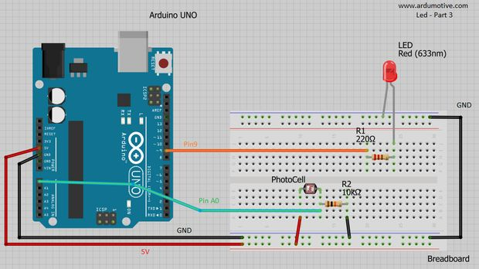
Wiring for photoresistor sketch

